Slide 2

Welcome

Slide 3
Stop your Calcs From Bugging Out!
#Data17

Slide 4



Nick Goodhartz Senior Product Consultant Austin, TX
#Data17
Nic Fuentes Product Consultant Austin, TX

Slide 5
SESSION REPEATS
Day of Week, Month Day Session Title
Time – Time | Location
Day of Week, Month Day Session Title
Time – Time | Location
Day of Week, Month Day Session Title
Time – Time | Location

Slide 6
RELATED SESSIONS
Friday, October 23 Beginning Your Geographic Analysis Journey
11:30am – 12:30pm | Location
Friday, October 23 Beginning Your Geographic Analysis Journey
11:30am – 12:30pm | Location
Friday, October 23 Beginning Your Geographic Analysis Journey
11:30am – 12:30pm | Location

Slide 7
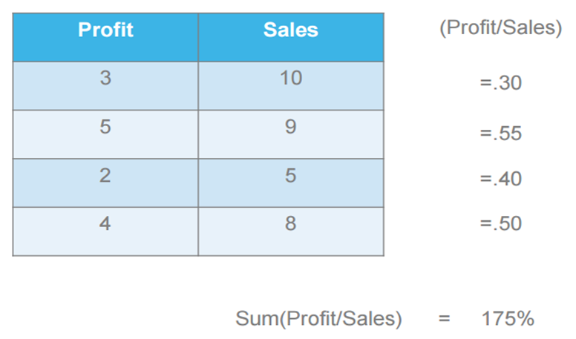
Aggregation vs. Disaggregation
Without aggregating, Tableau will compute each individual row level quotient. These disaggregate calculations will then allow you to choose how to aggregate, but we do not want to sum up or average these numbers at all.

Slide 8
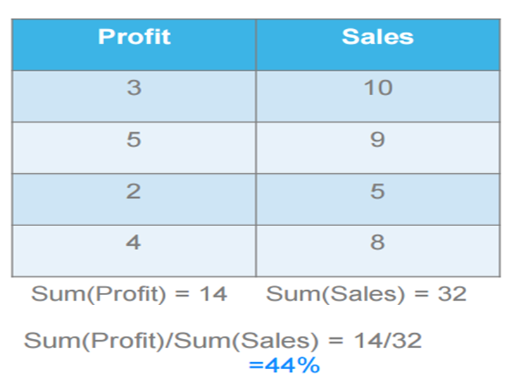
Aggregation vs. Disaggregation
Summing up profit and sales before dividing gives us the desired result for the ratio calculation. Tableau will re-compute the calculation at whichever level of detail is in the visualization

Slide 9
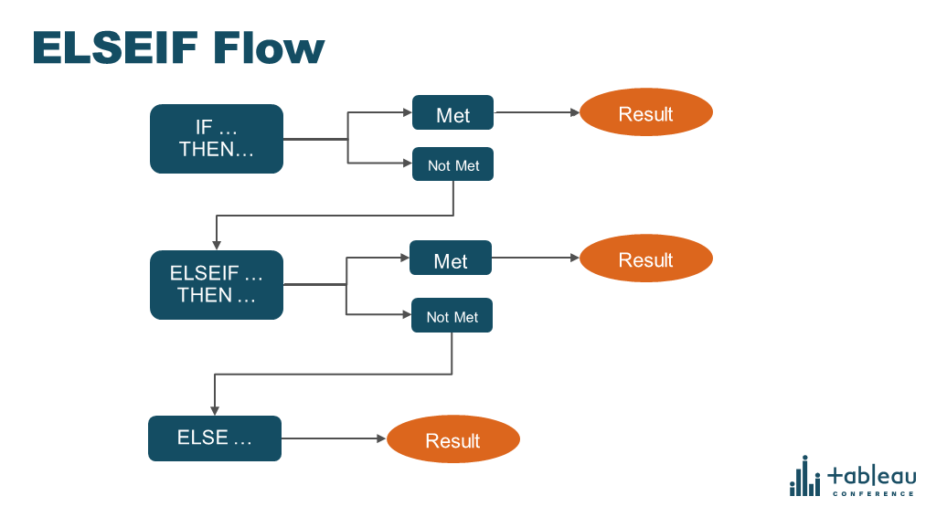
IF/THEN Flow

Slide 10
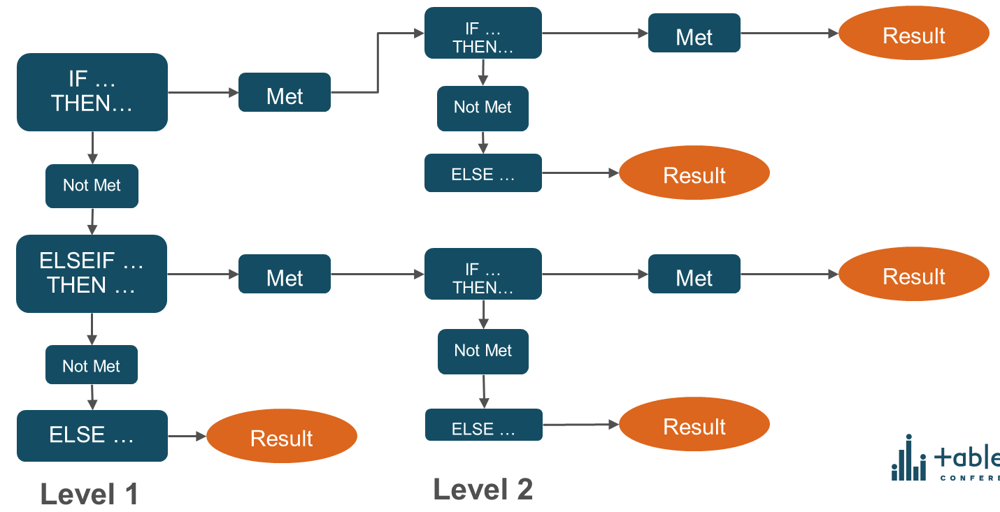
Nested IF/THEN Flow

Slide 11
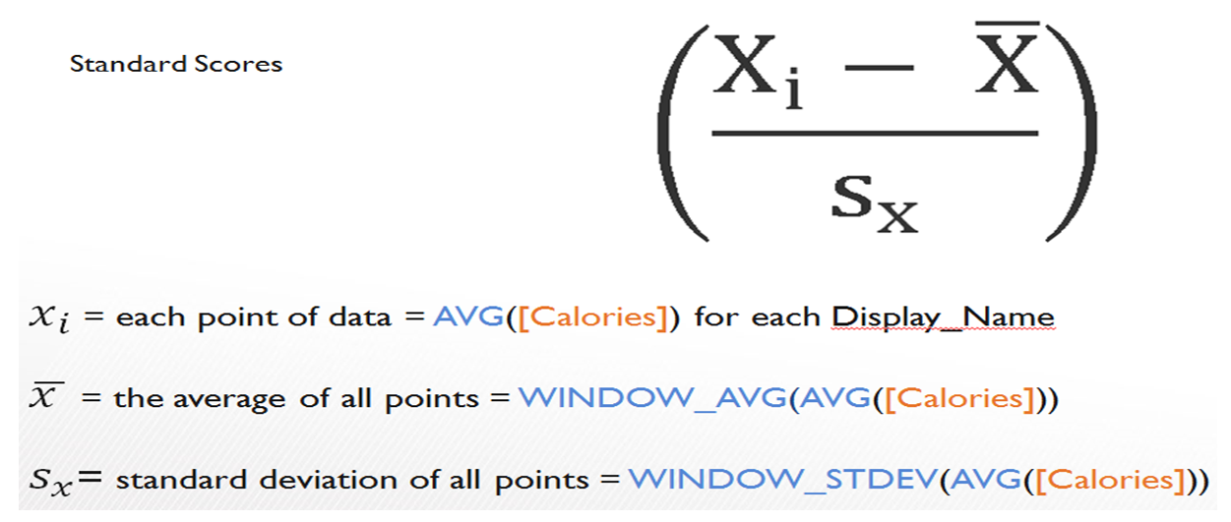
Converting a Math Equation to Tableau Syntax

Slide 12
Aggregation

Slide 13
Logic

Slide 14
Null Values

Slide 15
Dates and Times

Slide 16
Challenge Problems

